Slide 1
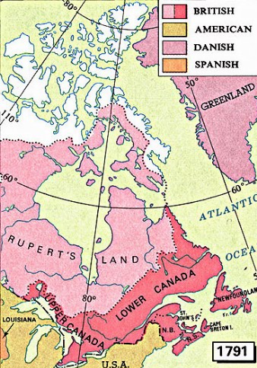
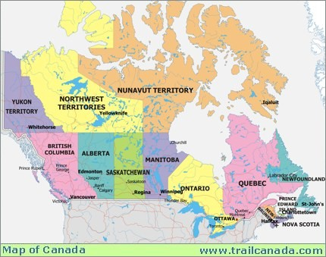
Formation Of Canada
Generally, North America was colonized by water rights:
British using the watershed of Hudson Bay
Russian: Water into the pacific
Spanish: Water of the Missippi basin (ceded to France)
French: Water of the Great Lakes
Wars that were adjuncts to European wars changed many boundaries
Southern Border determined by treaties with the United States in 1842 and 1871
The last Big British possession in North America, Newfoundland, was ceded to canada in 1949
Notes:
Using a design. Intermixed bullets and numbers. Wrong placement of pictures but can’t do anything about it.

Slide 2
Formation of Toronto
City begins as Fort York, erected to protect the western approaches of lake Ontario
In 1834, the city outside the fort is renamed Toronto, indian for meeting place
Today is it a bustling city of 2.5 million
Notes:
Used an already registered layout since there was only one picture

Slide 3
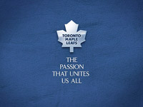
Toronto, Home of The Toronto Maple Leafs
One of 3 original teams of the NHL
Originally named the arenas, become the Toronto St Patrick’s and then the Maple Leafs on 1927
To the right is the original emblem of the team and below that is the modern emblem
Notes:
Again an already existing layout

Slide 4
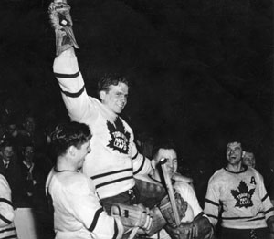
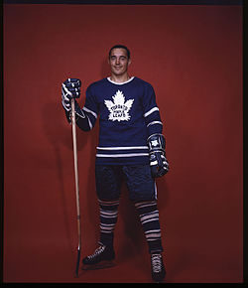
We highlight two players of the Toronto Maple leafs.
To the left is Bill Barilko who scored the winning goal in overtime to clinch the Stanley Cup for Toronto in 1951 (the 1950-1951 season). Tragically, a few months after this, he was lost in a plane crash in the Northwest Territories
To the right is one of the greatest hockey players ever, Frank Mahovlich, better known as The Big M. While playing for Toronto, he led the Maple leafs to several Stanley Cups on the 1960’s.
Traded to Montreal, he teamed with his brother Pete to help Montreal win the Stanley cup each season he was there
Notes:
By this point I am using a blank layout and inserting objects

Slide 5
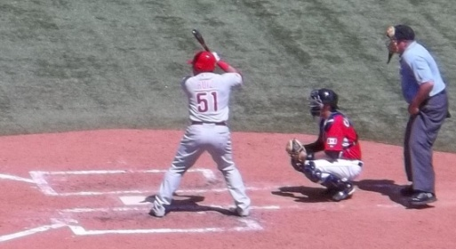
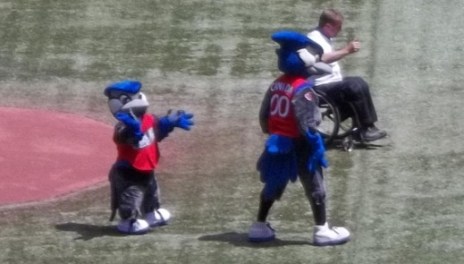
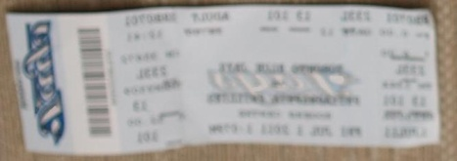
Toronto also has the Toronto Blue Jays
The Phillies were Playing the Blue Jays on July 1st of this year. You may recognize, in one of the pictures below, a spectator at this game.
Yes, your instructor, while up in Toronto for a dance festival, also bought tickets to the game.
The Phils won 7-6 but the Toronto fans were very welcoming.
July 1st was Canada Day and the pre game activity was extremely moving with the Canadian Armed Forces being highlighted.
Notes:
4 pictures

Slide 6
Toronto: North America’s Trolley Capital
Toronto is the trolley captial of North America with 12 lines running service through the area
Many routes are on their own right of way in the center of major boulevards
There are many instances to 2 way lines intersecting 2 way lines. This is unique within our continent at this moment.
Below right is a catenary system, The catenaries provide the trolleys with power but also allow the operator to switch the rail points from his cab
The “Red Rocket” pictured top right was built within Ontario as a light rail vehicle in the 1990’s

Slide 7
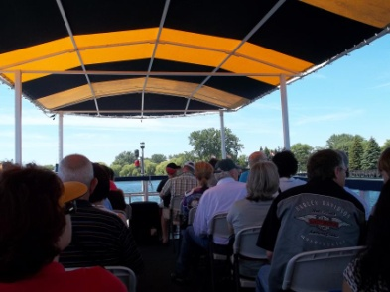
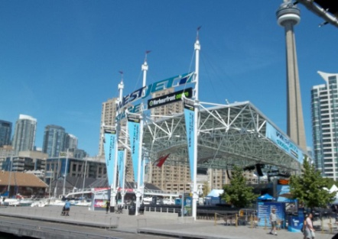
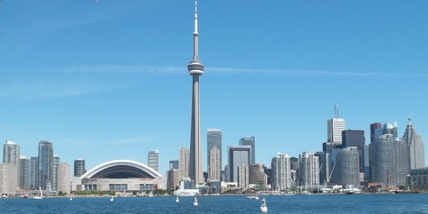
And, finally there was touring on and off Lake Ontario as indicated in the pictures below
July 1st is Canada day and Toronto marks this day with a great many parades, fairs and events.
The two women top right partook of these events while on a tour of the city.
There trip included a boat ride along Lake Ontario and a visit to the CN tower as indicated bottom right
Notes:
Notice the design edge is not breached in these screens. It acts like an additional margin

